Slide 1

Go, change the world
RV College of
Engineering
OLAP

Slide 2
OLAP
(online analytical Processing)

Slide 3
INDEX
Recap
OLAP - Introduction
OLAP - History
OLAP - CUBES
OLAP - CUBES Examples
OLAP - Architecture
OLAP - Use Case
OLAP - Operations
OLAP - Providers
Conclusion

Slide 4
INTRODUCTION and RECAP
Database
Collection of related data
Database System
Database and database
software together
Data Warehouse
Collection of information and supporting system

Slide 5
Traditional Database
Data Warehouse
(Relational, Object Oriented,...)
Deals with large amount of data
Transactional, supports OLTP (Online Transaction Processing)
Optimized for Data Retrieval
CRUD (and information query)
of few tuples
Supports high performance demands on an organization’s data and information

Slide 6
Data Warehouse
Provides access to data for:
Complex Analysis
Decision Making
Knowledge Discovery
Applications:
OLAP
Decision Support System
Data Mining

Slide 7
OLAP
Decision Support System
Data Mining
Supports organization’s decision makers with higher-level data for complex and important decisions
Analysis of complex data from the data warehouse
Knowledge discovery: the process of searching data for unanticipated new knowledge

Slide 8
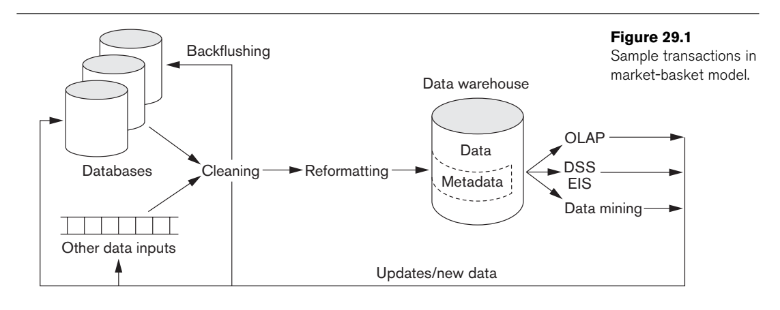
Data Warehousing Process

Slide 9
OLAP (INTRODUCTION)
Important way of organizing and presenting data
OLAP is a software technology you can use to analyze business data from different points of view
Organizations collect and store data from multiple data sources. OLAP combines and groups this data into categories to provide “actionable insights” and business intelligence (BI)

Slide 10
OLAP - History

Slide 11
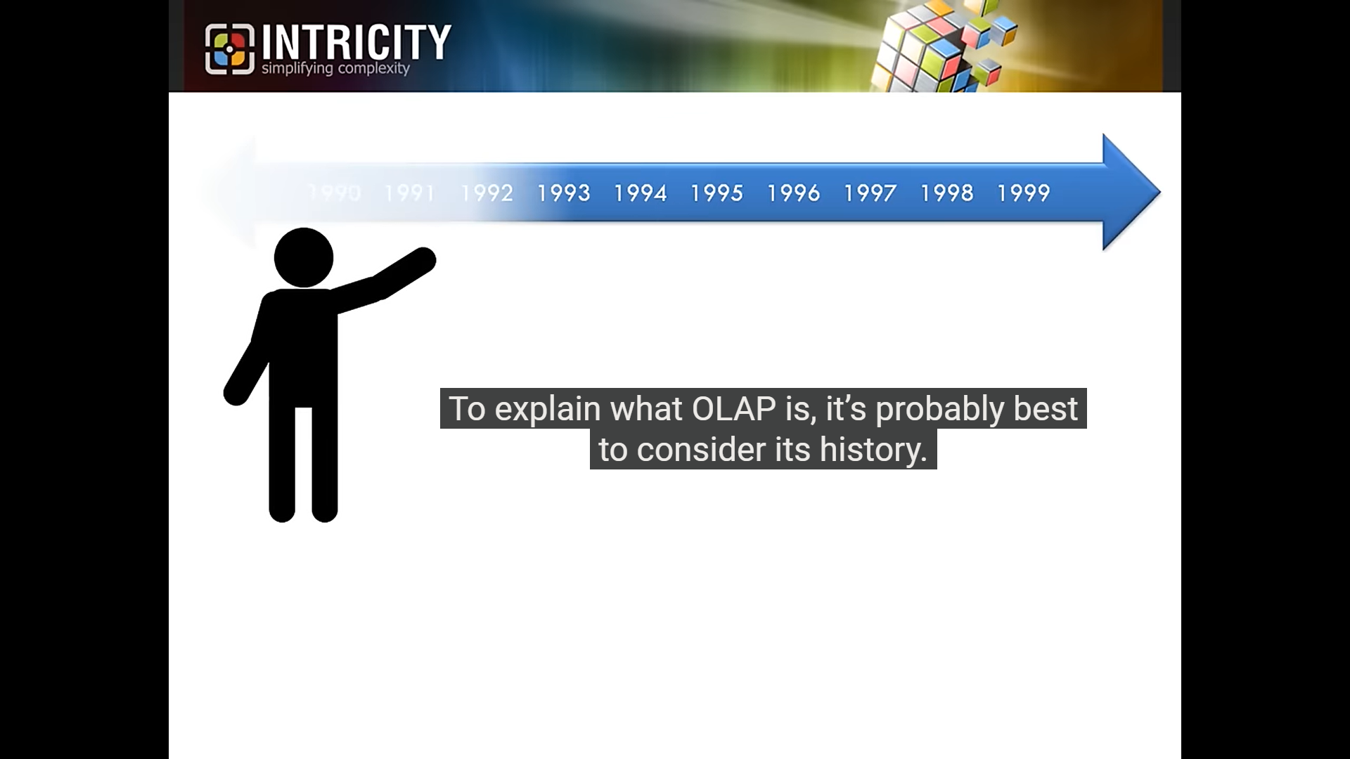

Slide 12
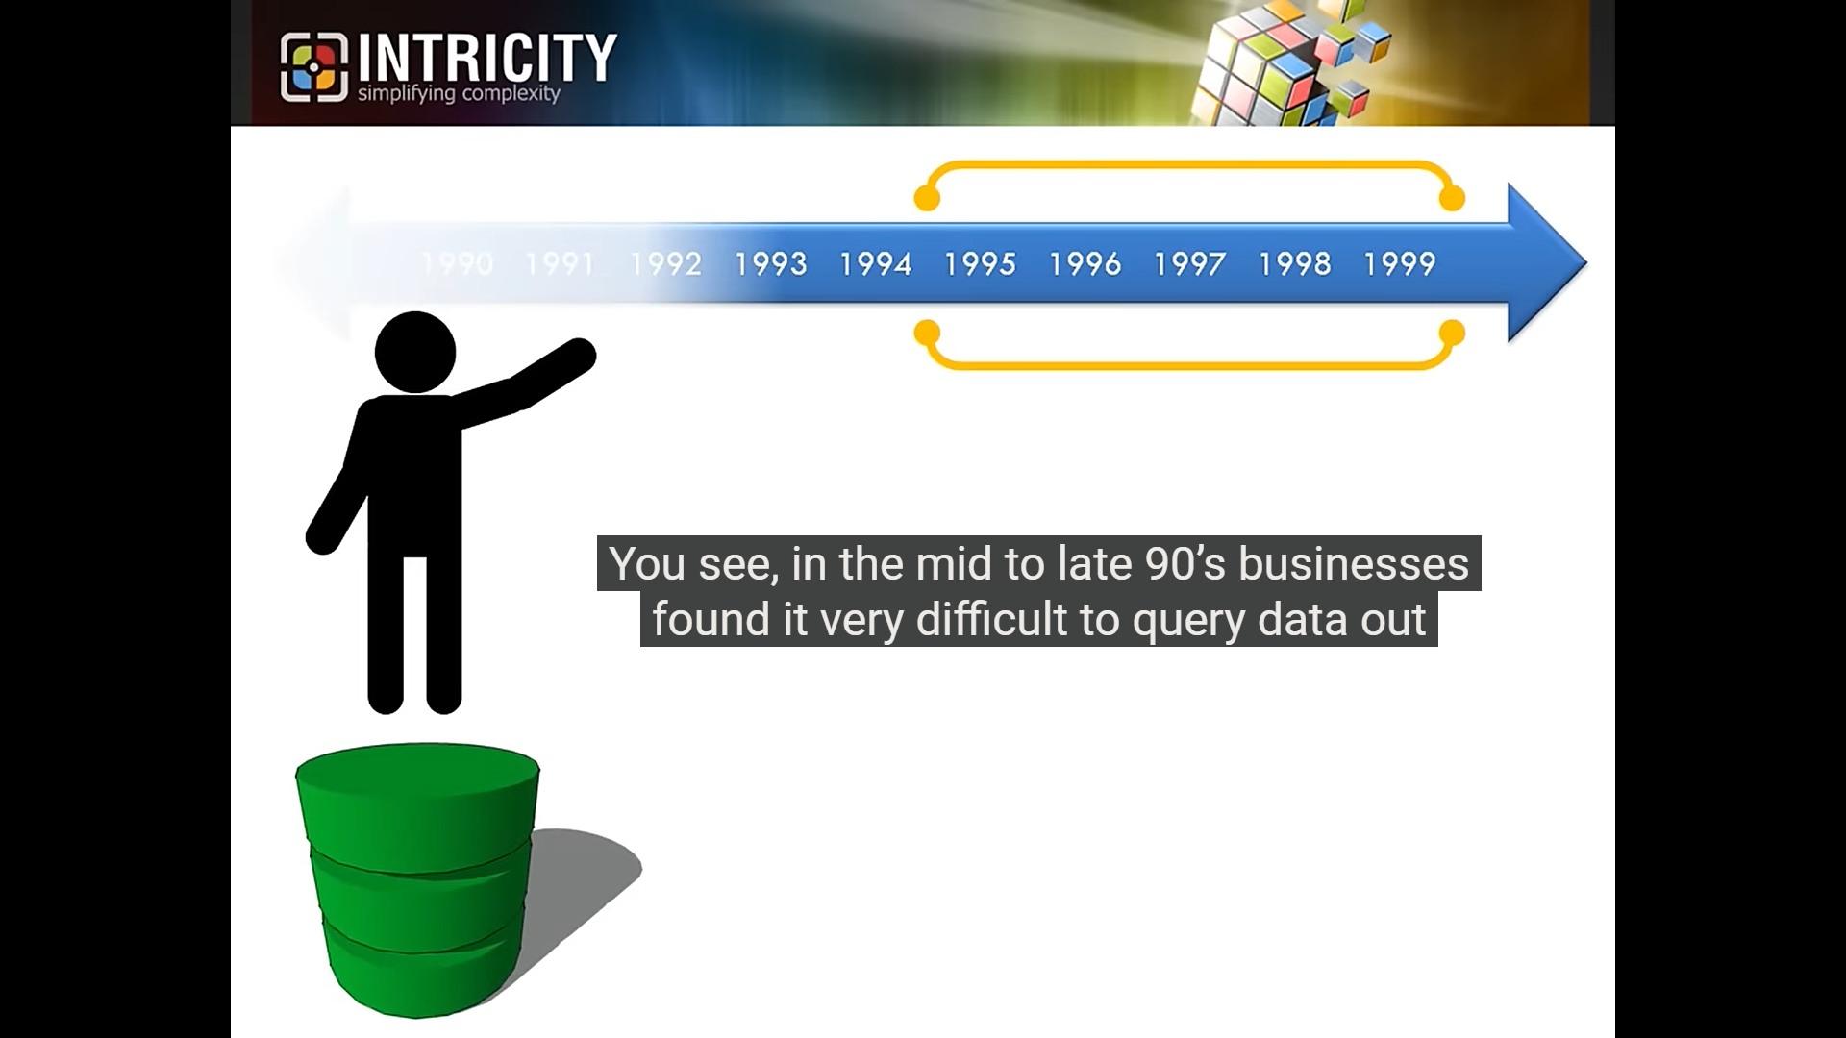
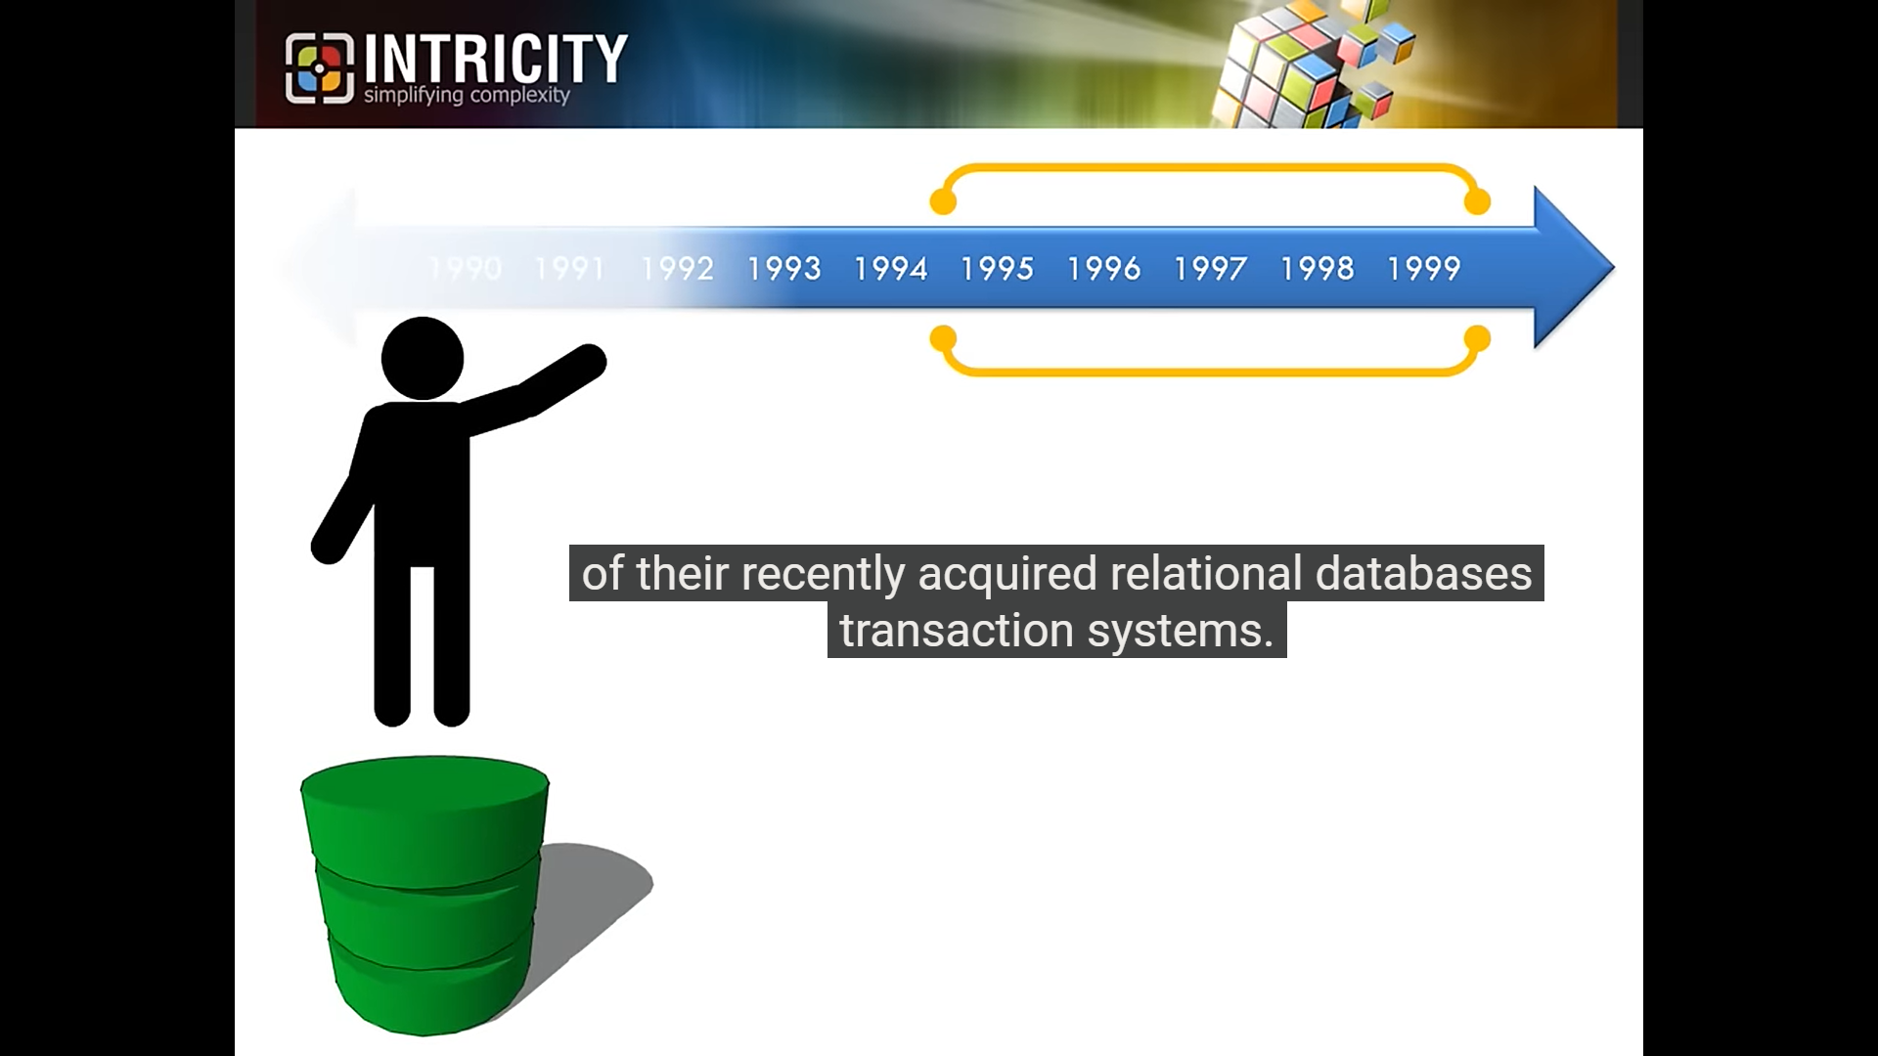

Slide 13
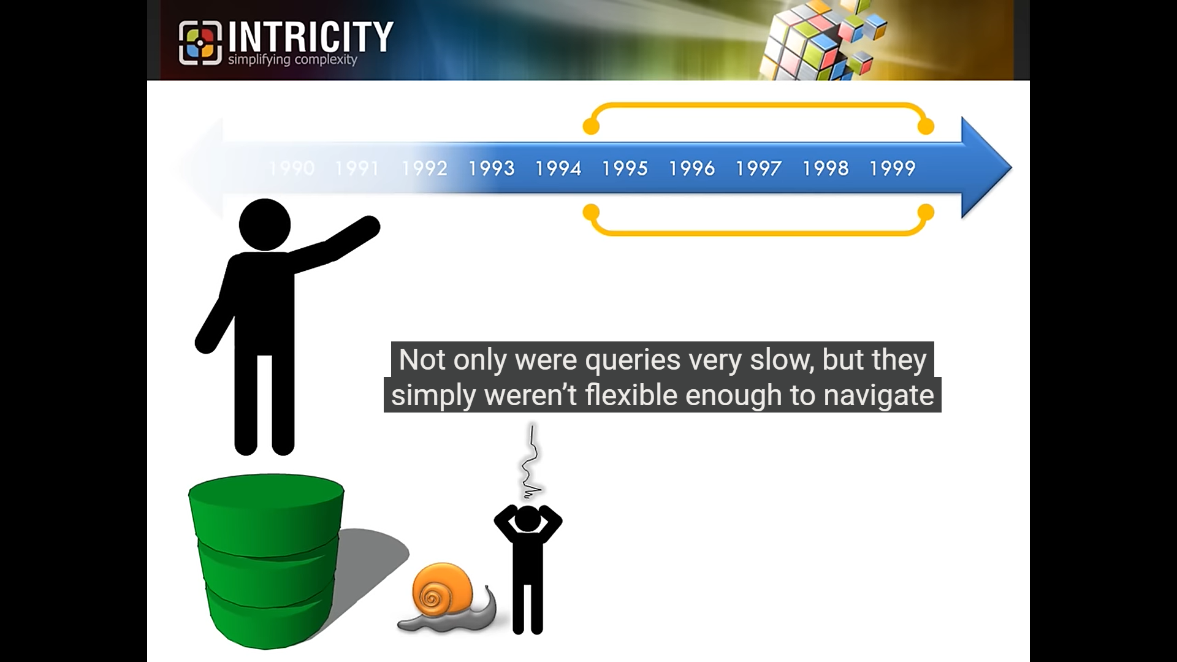

Slide 14
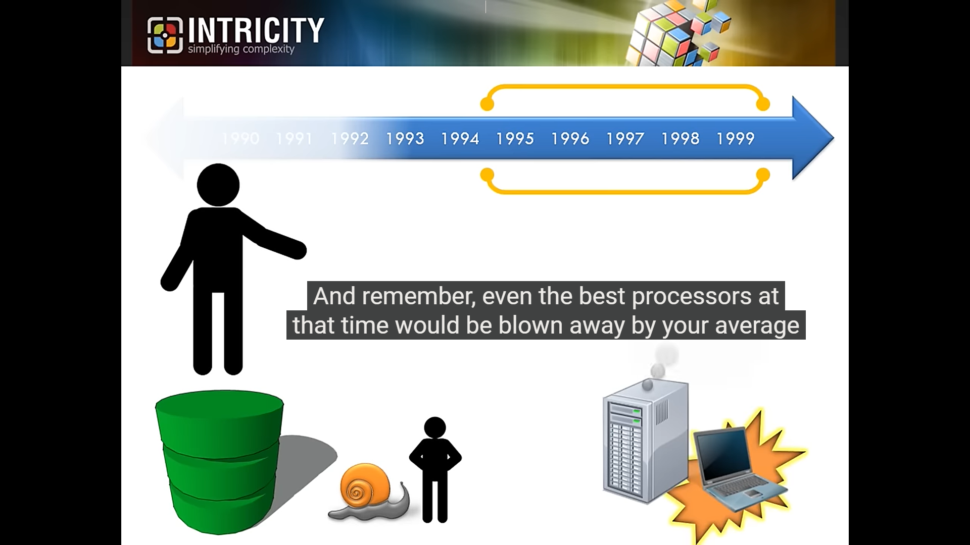
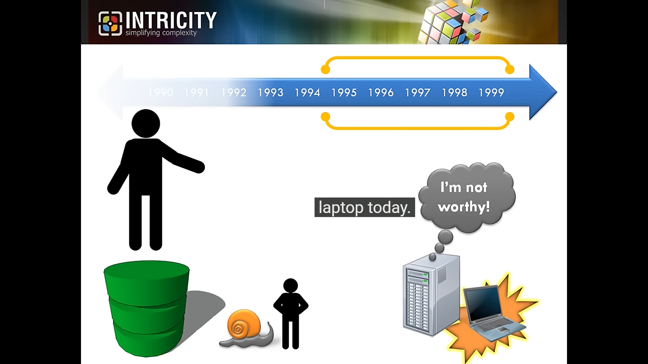

Slide 15
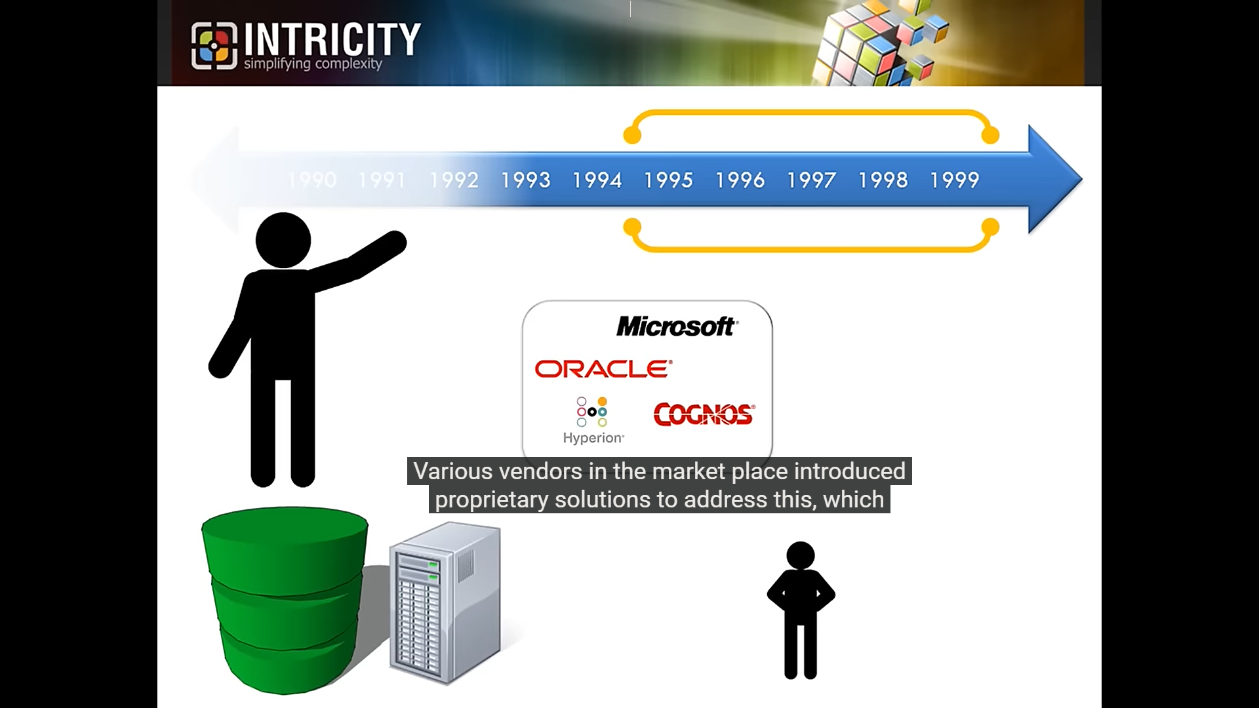

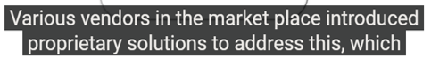



Slide 16

First termed in 1990s.
By Edgar F. Codd (the father of relational database) in his paper
Codd E.F.; Codd S.B. & Salley C.T. (1993)
"Providing OLAP (On-line Analytical Processing) to User-Analysts: An IT Mandate"

Slide 17
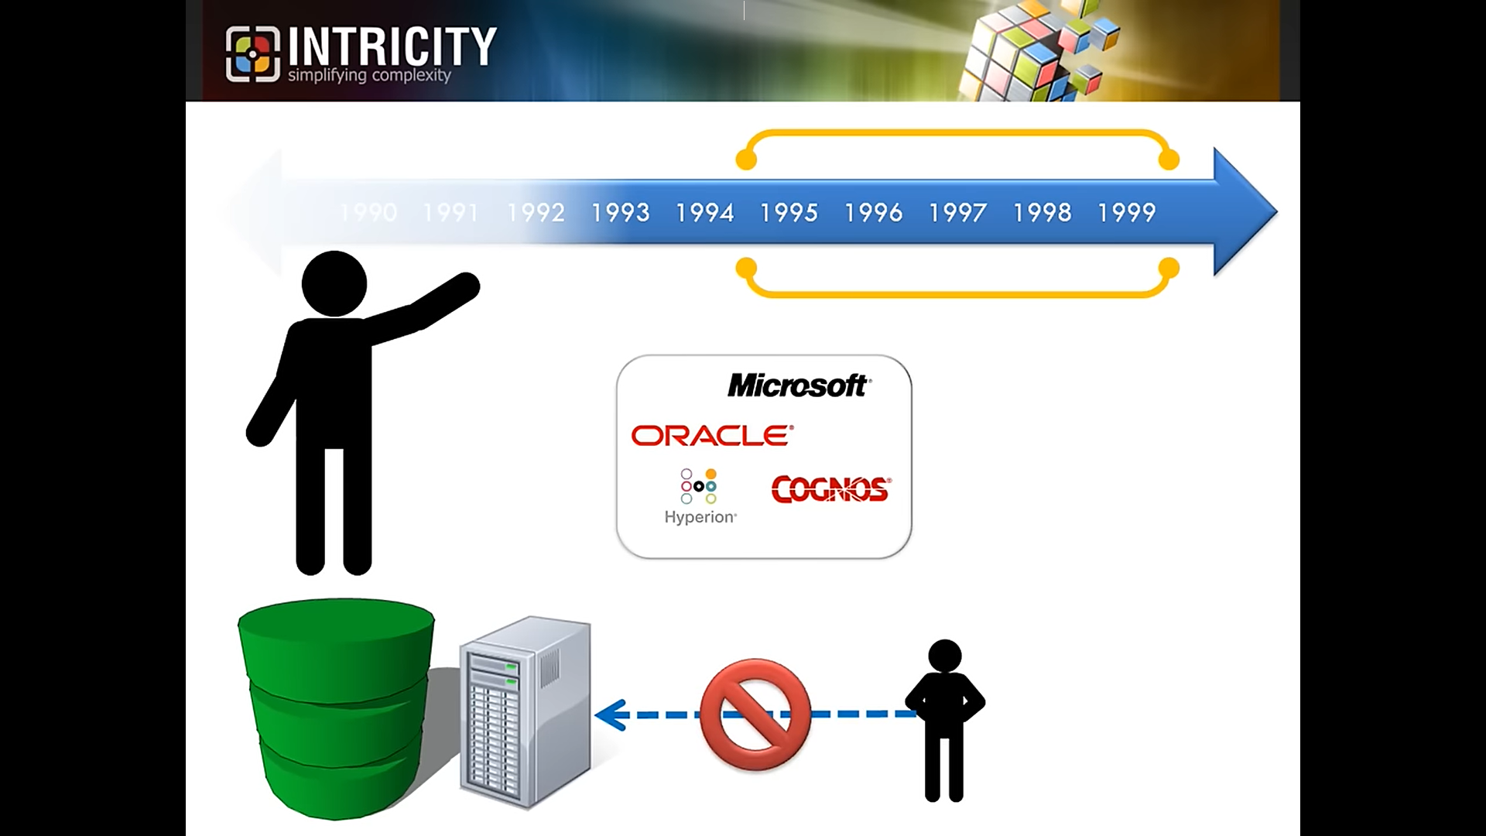



Slide 18
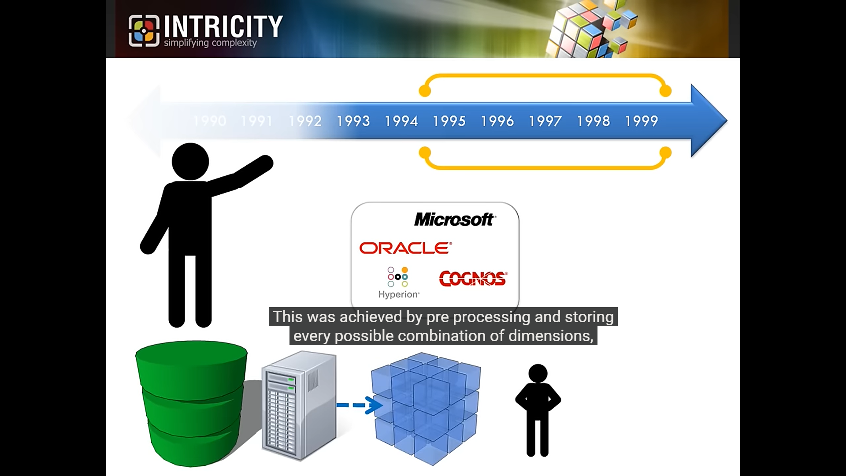




Slide 19
OLAP (Drawbacks of traditional database)
Today, nearly every business collects reams of data
But many of them still store and analyze it in a database
Data is presented two-dimensionally
For each item of data, row and column must always have an entry, even if there are duplicate entries (eg: location)
This results in very large database that is slow, conflicting and difficult to work

Slide 20

OLAP (Better approach)
OLAP allows data to be stored in three or more dimensions
Presented in the form of cube, the same data is to be entered only once
This results in faster searches and easier extraction
Also, cubes can be sliced, diced and rotated, allowing the user to narrow or broaden a search and take a variety of approaches to visualizing the data

Slide 21
CUBE
Cubes
Three Dimensional data More than three dimensions
The OLAP cube's data structure is optimized for rapid data analysis
How is it optimized? By storing pre-calculated and aggregated data
Hypercubes

Slide 22
Why is OLAP efficient?
It’s all about how OLAP handles data. OLAP creates pre-computed results, storing them in multi-dimensional cubes. When multiple analysts/applications run the same data-intensive operation, it doesn't overburden the primary data system.
Analogy:
Think of it as cooking a large meal once and then serving it to many people, rather than cooking the same meal repeatedly for each person

Slide 23
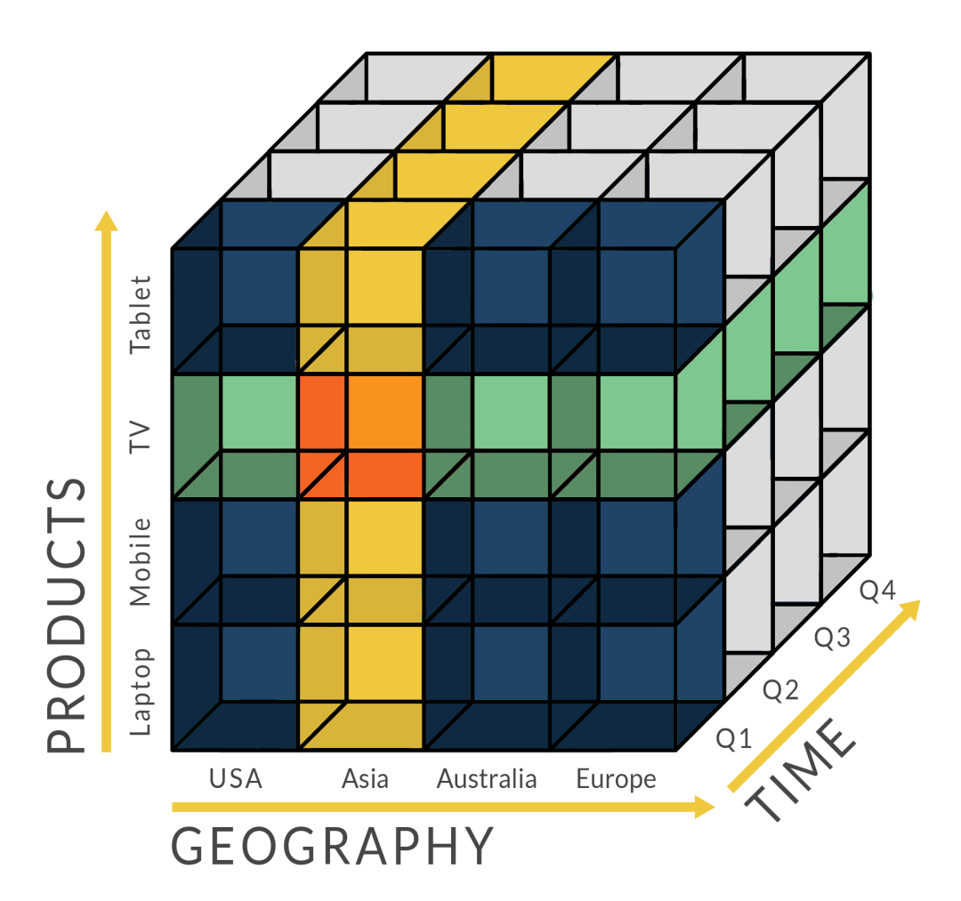
CUBE – Example 1

Slide 24
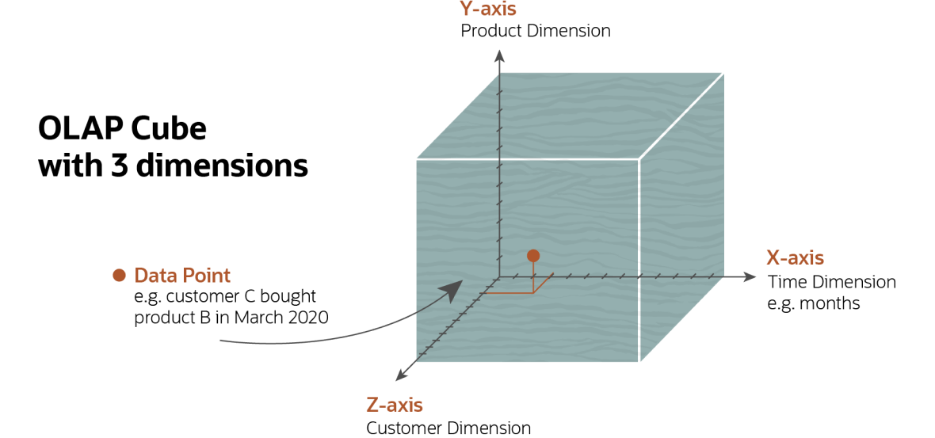
CUBE – Example 2
Company might organize its sales data by
Product
Customer
Timeframe
for comparative purposes.

Slide 25
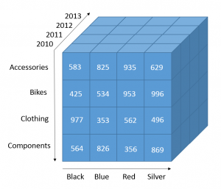
CUBE – Example 3
Company may summarize sales data by
Product (y axis)
Time period (z axis)
Color (x axis)
to compare and quickly gather insights on sales results

Slide 26
OLAP - Architecture

Slide 27
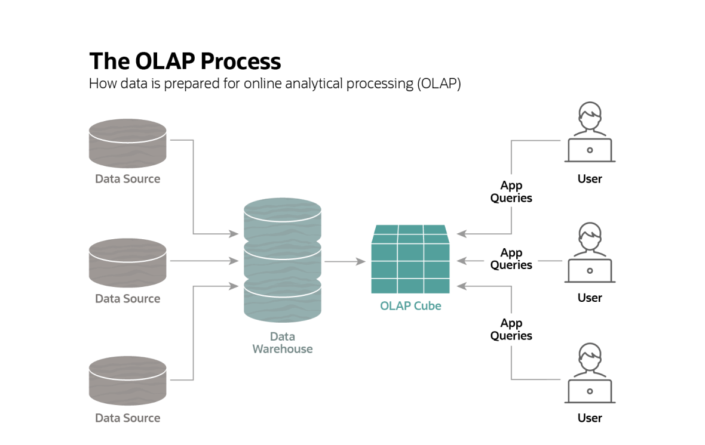
OLAP works by extracting data from multiple sources and formatting it into cubes, which can then be analyzed from multiple points of view.

Slide 28
OLAP – Use case

Slide 29
A business company may want to track “Monthly Sales”
One way: Display “products” in y axis and “months” in x axis.
Realistically, however, a business may also want to track its SALES by an additional factor: location, salesperson, discounts,…
Managers need to do this in order to
answer particular questions ("Why did this product stop selling in Chicago in July?")
and to get a more complete picture of how the business is faring ("Why was revenue flat even though sales were up for the year? Was too much discounting taking place?")

Slide 30
Dimensions can be added to OLAP cube to track each of these additional factors.
Then managers can take any view — slice, section, angle of the cube — to produce a report that contains the key points of interest.
Monthly product sales in San Francisco? No problem.
Compare sales in months with more discounting to months with less discounting? Also done in a snap.
Better still, any of this data can be presented visually, making it much easier to identify trends.
And the view can be changed by simply rotating the cube. So, a chart that shows which products sold best in New York in November can be turned to show in which month products sales were best in New York

Slide 31
OLAP - Operations

Slide 32
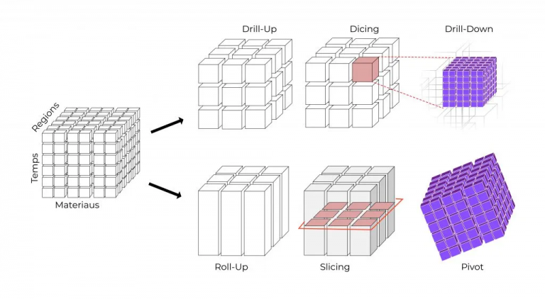
Overview

Slide 33
DRILL DOWns
Drill-downs provide a closer look and reveal more details about the data.
Methods:
Moving down in the concept hierarchy or
Adding a new dimension to the cube
Years
Months

Slide 34
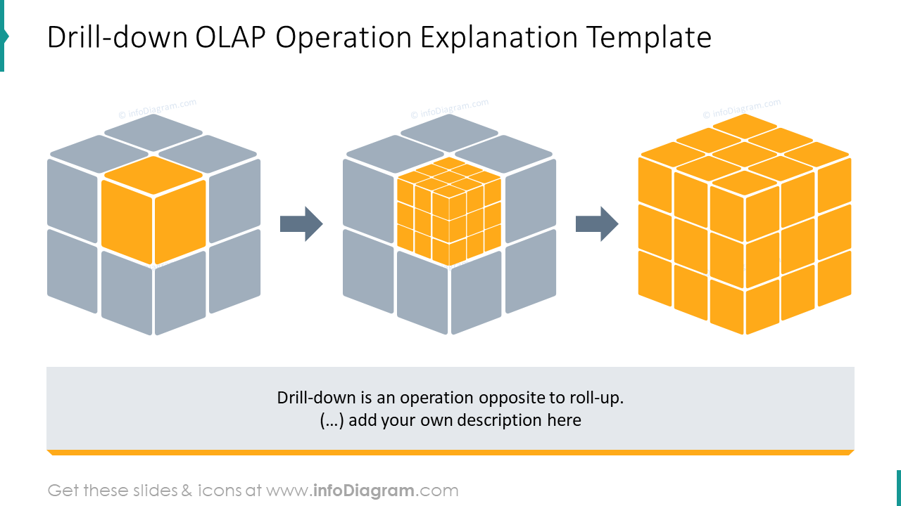

Slide 35
ROLL UPS
Roll-ups are the opposite of drill-downs
Roll-ups summarizes the data for particular attributes
For example, you might view sales according to cities California, London, Tokyo. A roll-up would provide a view based on countries, such as the US, UK, Japan
it aggregates data on an OLAP cube by moving up in the concept hierarchy or by reducing the number of dimensions.
Cities
Countries

Slide 36
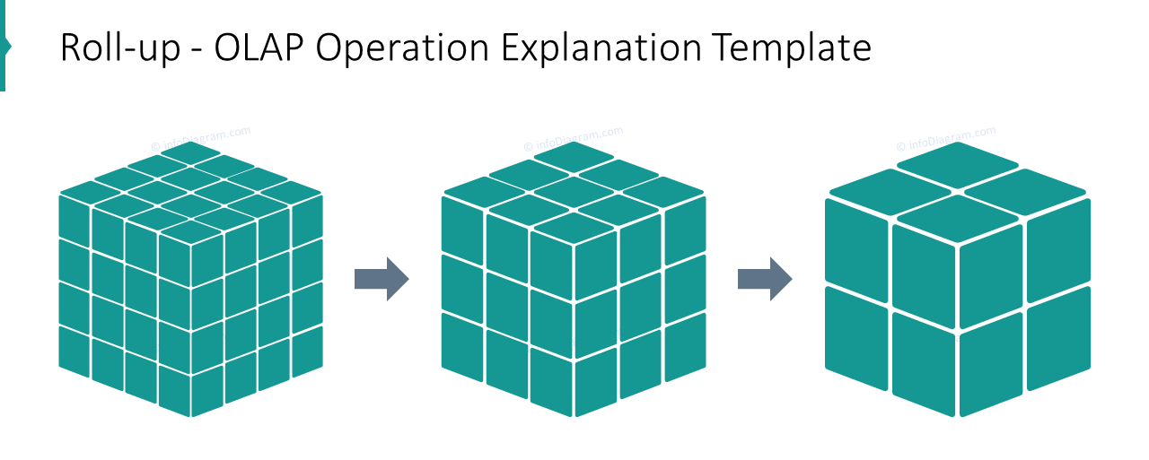

Slide 37

SLICING
Slice operation is used to create a two-dimensional view from the OLAP cube
For instance, slicing the data by time can highlight all sales data for a year
Enables to take one level of information for display, such as "sales in 2020"

Slide 38
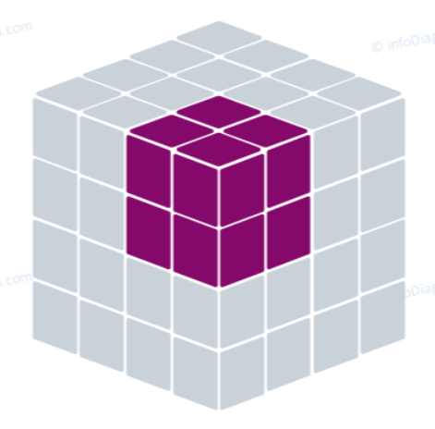
Dicing
Dicing a smaller “sub-cube” out of a larger OLAP cube
Enables to select data from multiple dimensions to analyze, such as “Sales of Shoes in Mumbai in 2020"

Slide 39
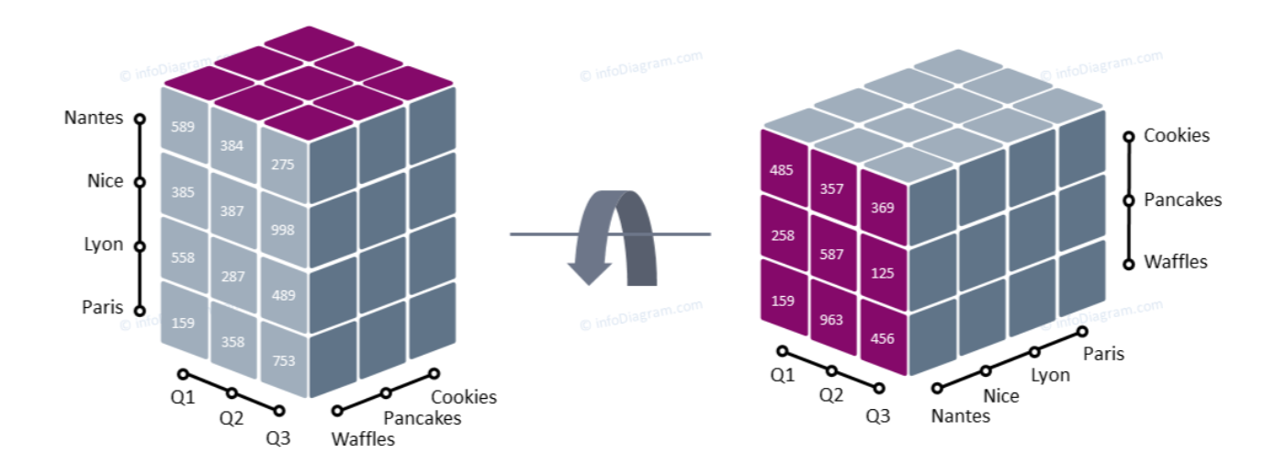
PIVOTING
Pivoting or Rotating gets a new view of data by rotating the data axes of the cube
For example, instead of comparing sales by TIME, it can be rotated to compare sales by LOCATION

Slide 40
OLAP Providers

Slide 41
PRODUCTS
OLAP Products include
IBM Cognos
Microsoft Power BI
Oracle OLAP
AWS
OLAP features are also included in tools such as
Microsoft Excel
Microsoft SQL Server's Analysis Services

Slide 42
How does AWS help with OLAP?
AWS databases provide various managed cloud databases to help organizations store and perform online analytical processing (OLAP) operations.
Amazon Redshift is a cloud data warehouse designed specifically for online analytical processing.
Amazon Relational Database Service (Amazon RDS) is a relational database with OLAP functionality.
Amazon Aurora is a MySQL- and PostgreSQL-compatible cloud relational database. It is optimized for running complex OLAP workloads.

Slide 43
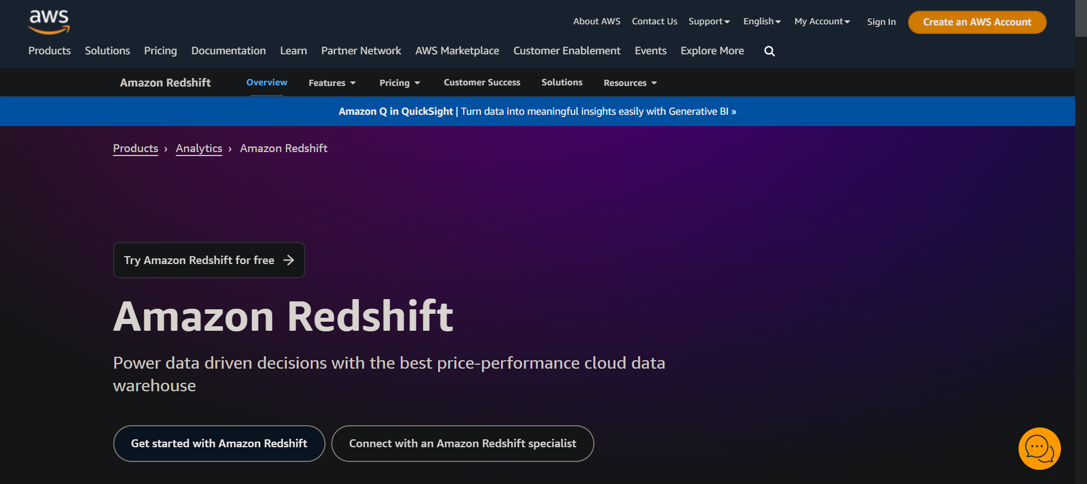

Slide 44

APACHe kylin
The criticism often heard is not about OLAP itself but about older OLAP technologies, such as IBM Cognos and SSAS. The older systems have issues like rigid manual modeling that needs a lot of upkeep, limited data cube sizes, and inadequate scale-up architecture
Open-source OLAP tools like Apache Kylin, and its commercial OLAP software counterpart Kyligence, combine proven classic precomputation theory with new big data and AI technologies to create Augmented OLAP

Slide 45
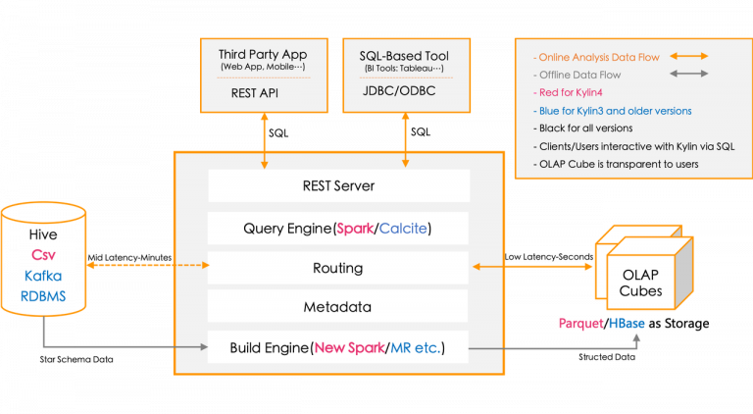
APACHe kylin
Apache Kylin OLAP Architecture

Slide 46
CONCLUSION

Slide 47
HOW OLAP IS USED
Because OLAP lets business leaders quickly perform an ad-hoc data analysis in a variety of ways, it can be a potent tool for making better-informed decisions.
It is ideal for data mining and trend analysis, and for performing complex analytical calculations, including data modeling.
The software is also well suited for more routine business functions, such as
financial reporting, budgeting, sales forecasting
Consequently, OLAP serves as the foundation for many different business applications,
BI, business performance mgmt (BPM), simulation modeling

Slide 48
ADVANTAGES
OLAP provides fast and intuitive data analysis and reporting.
Easy to use, it allows business managers and analysts to perform operations without requiring specialized skills.
disADVANTAGES
OLAP depends on IT teams for its functionality, and this may be its biggest drawback.
Data should be in warehouse, and modifications on cube structure requires support
Dimensions of the Cube

Slide 49
THANK YOU

